Slide 1
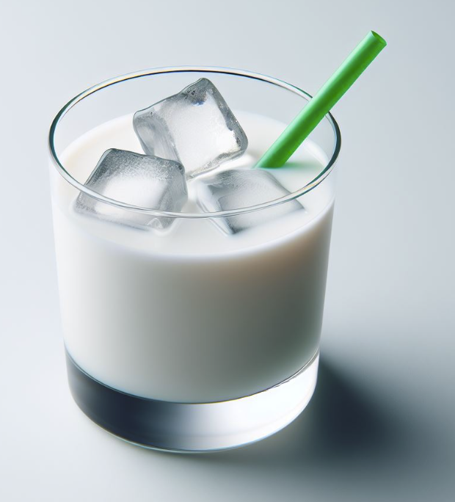
Diet Vilk – The CPU

Slide 2
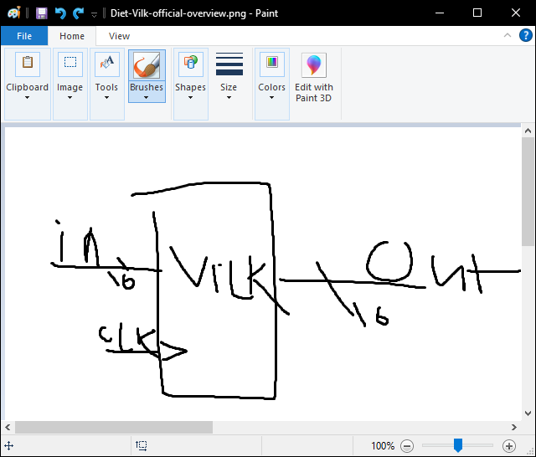
Memory To Memory
Loads Opcodes, memory addresses, and labels, one cycle at a time
Loads memory addresses, not values, from the PC
Uses registers to hold values after they are loaded. These registers are inaccessible to the programmer
Notes:
ethan

Slide 3
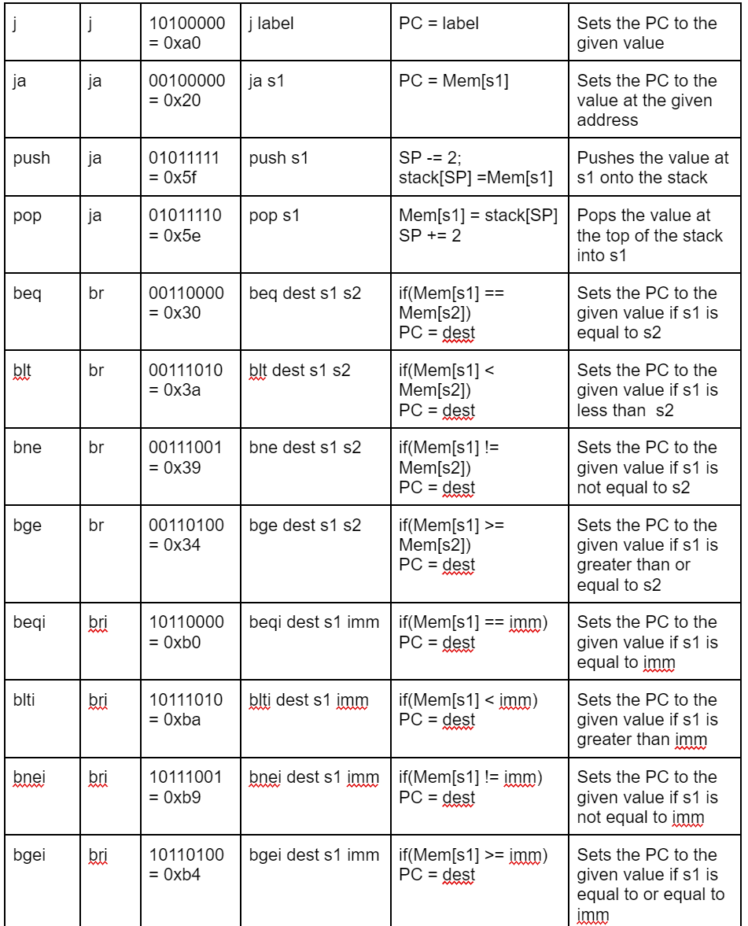
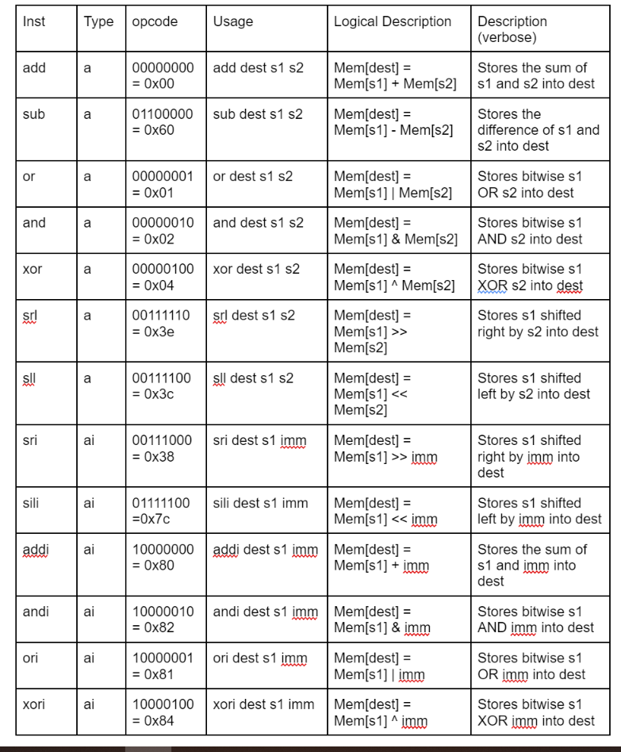
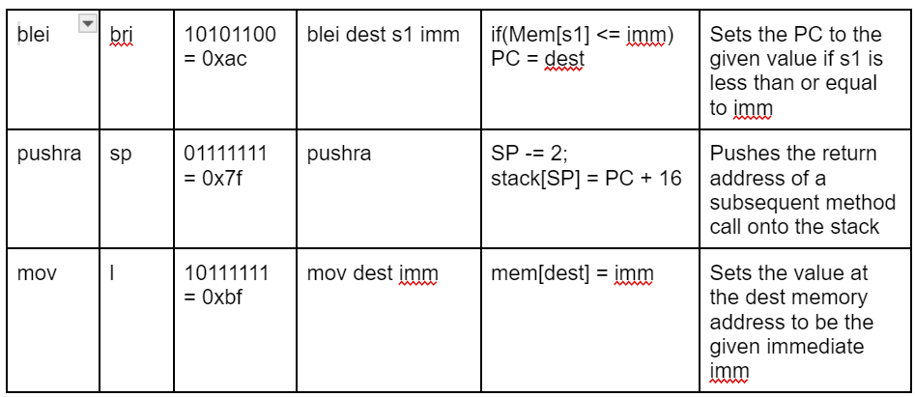
Instruction Set
Unique instructions
Comparing immediates
Pushra
Push, pop
Mov
All jumps and branches are absolute
Notes:
Talk about the opcodes being gibberishh
Ethan

Slide 4
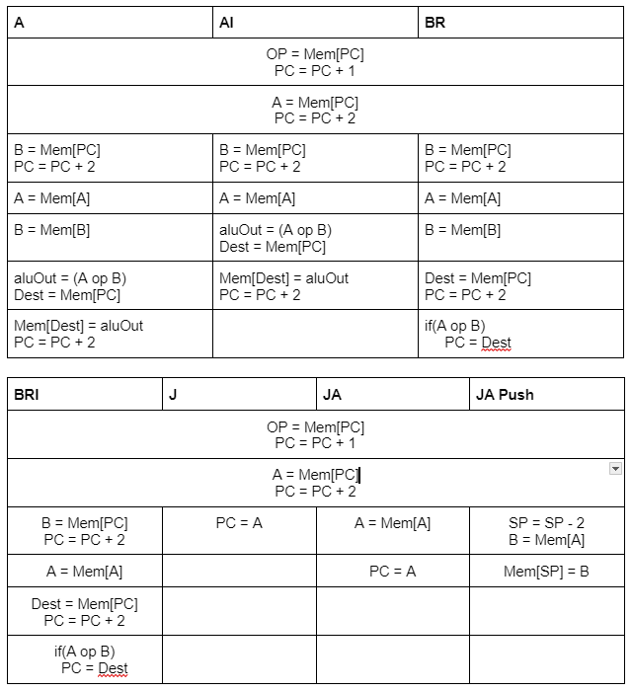
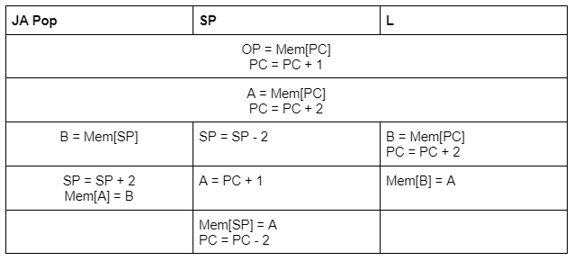
RTL
Only unique type is SP, L, JA, J, JA Push, JA Pop
Notes:
Wesley
Talk about the long instructions

Slide 5
Calling Conventions
Caller:
Push any data to be saved
Push any arguments
Call pushra
Jump to the function
After:
Pop any returned values
Pop any saved data
Callee:
Pop RA
Pop any arguments
Do the function
Push return values
JA to RA
Notes:
Ethan

Slide 6
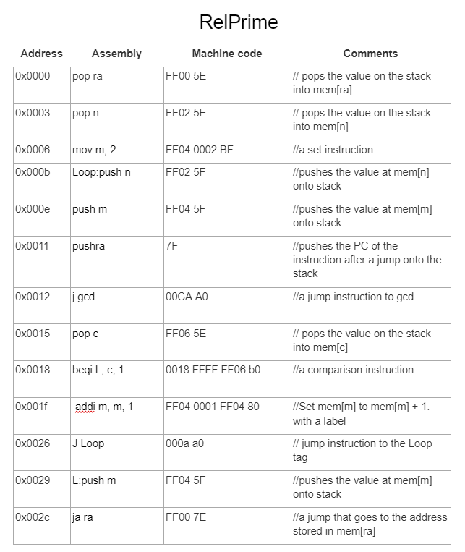
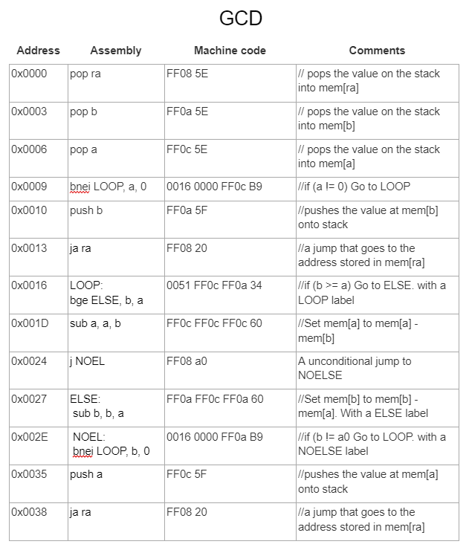
Code Snippets
Notes:
Wesley

Slide 7

Notes:
Garrett
To run the test bench with minecraft at the normal tick rate would take just under 36 days

Slide 8
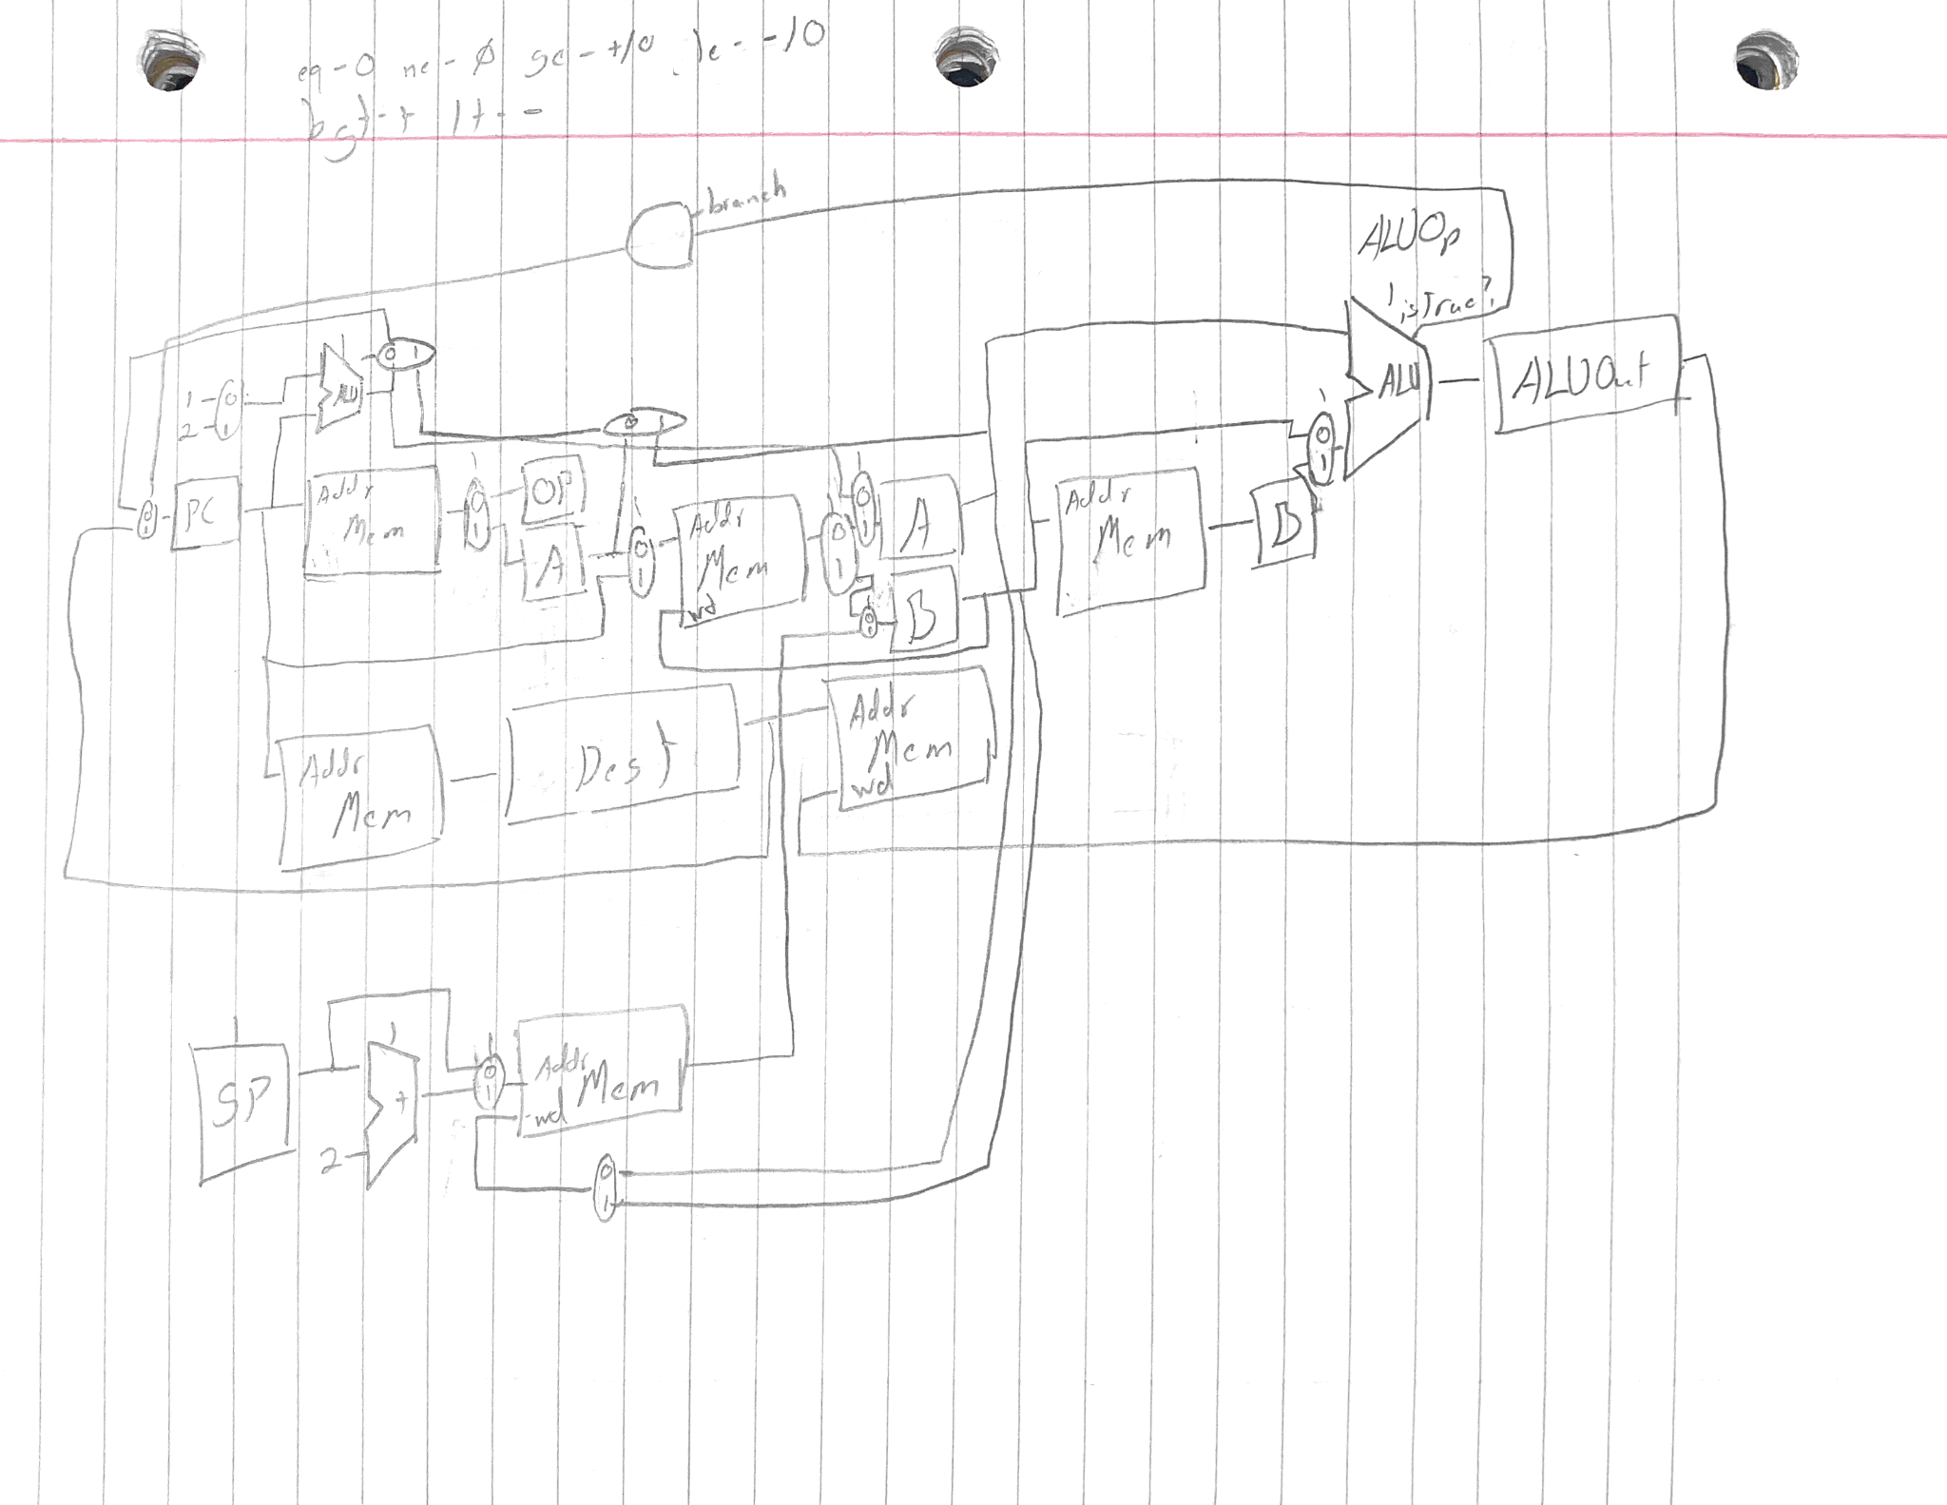
The Original Datapath
Notes:
Talk about the memory modules
ethan

Slide 9
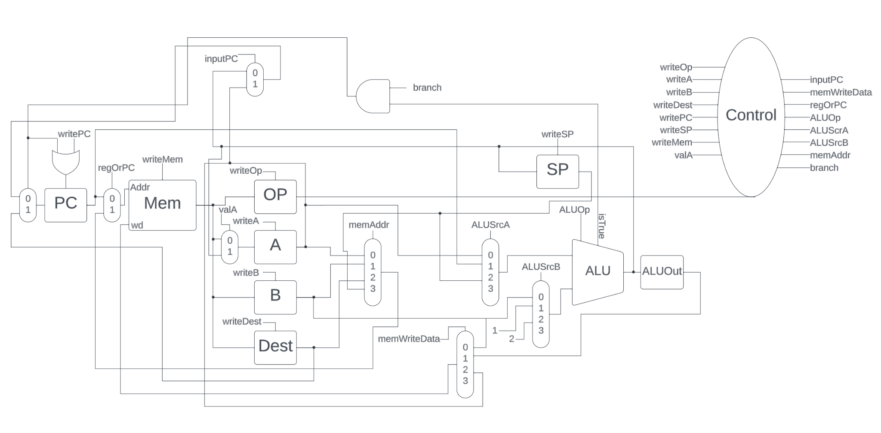
THE DATAPATH
“It’s not my fault you guys made such a baller datapath” - Garrett Doolittle
Notes:
ethan

Slide 10
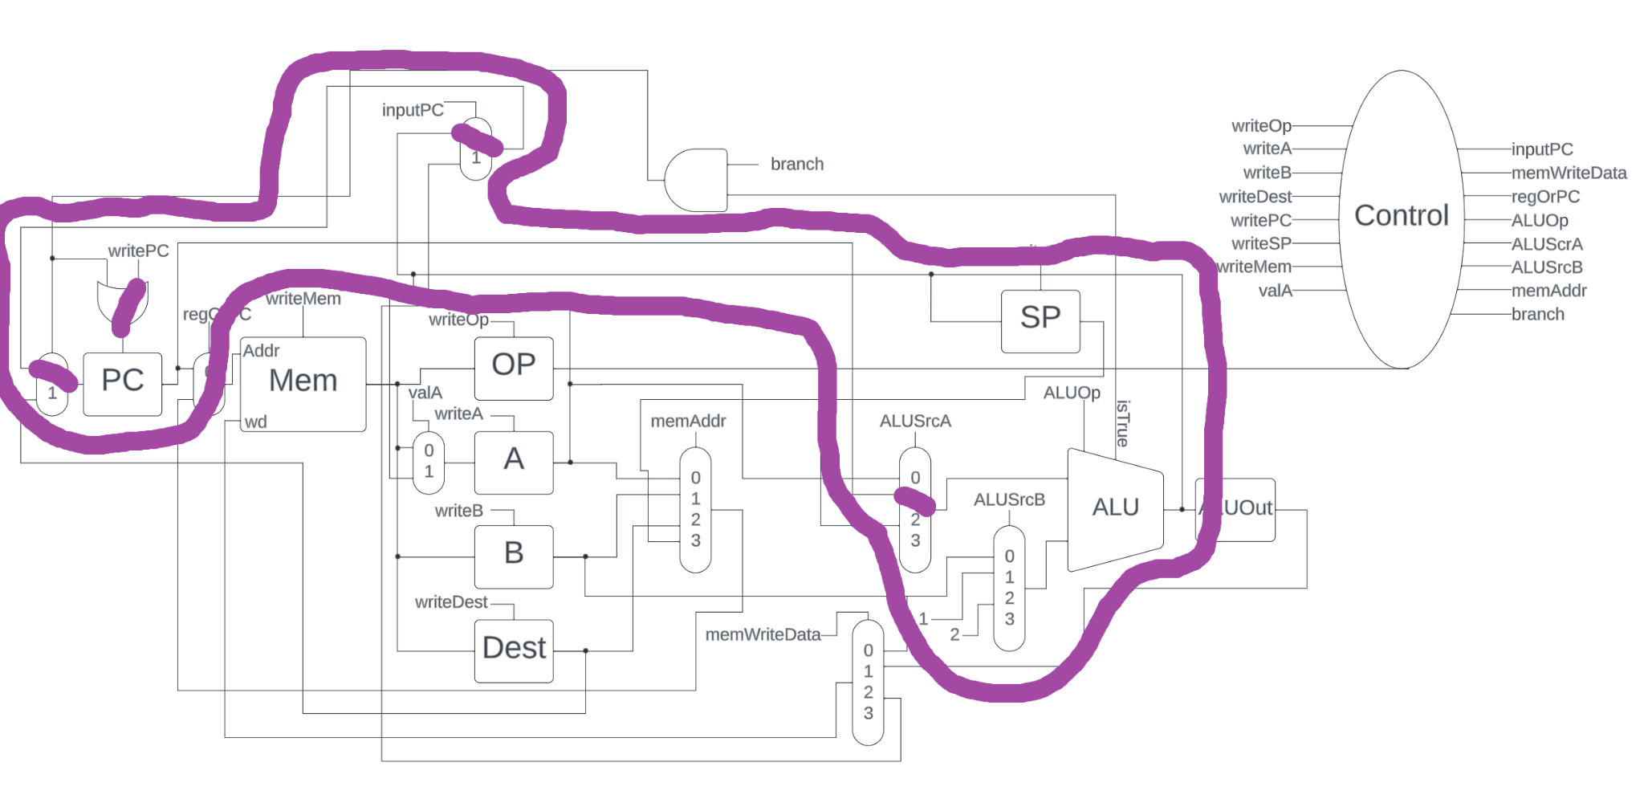
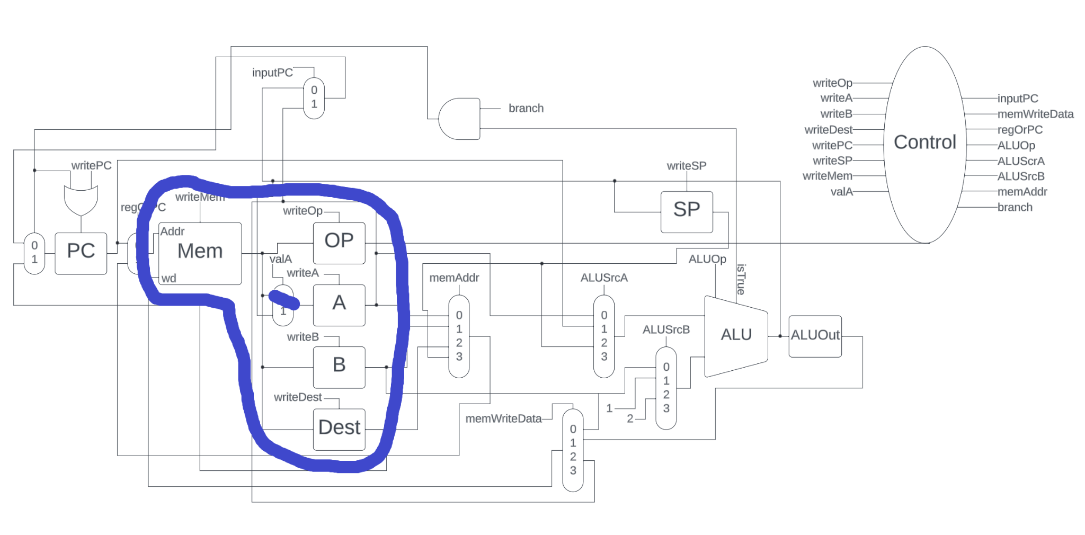
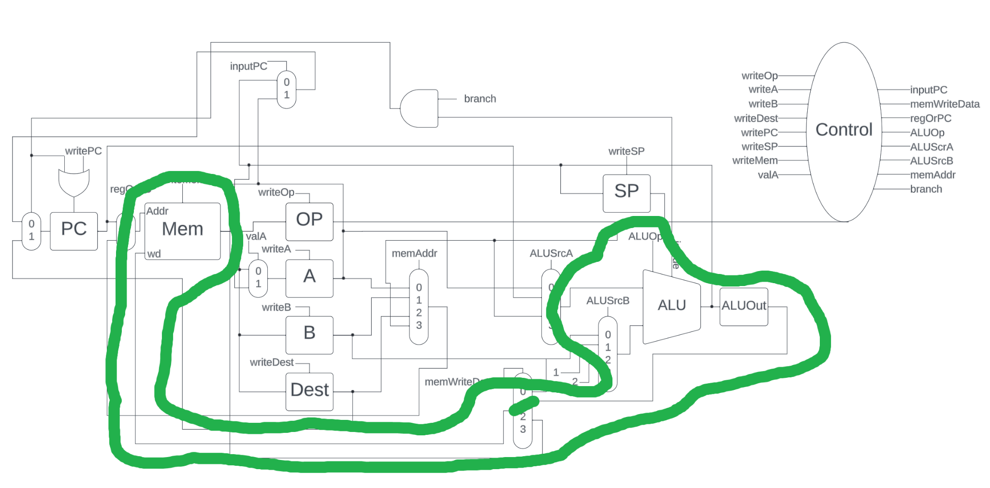
Testing
Build and test components
Connect components into 3 different stages
Test the different stages
Connect the stages
Notes:
Wesley

Slide 11
Unique Challenge
Memory
Notes:
Garrett
First compile as straight registers. Then after tweaking it a little it told us that it was compiling as memory. But if you looked the memory usage in quartus it was still at zero. Then with a lot of later tweaking it finally compiled correctly and worked correctly by using an inverted clock signal for reading and writing memory.

Slide 12
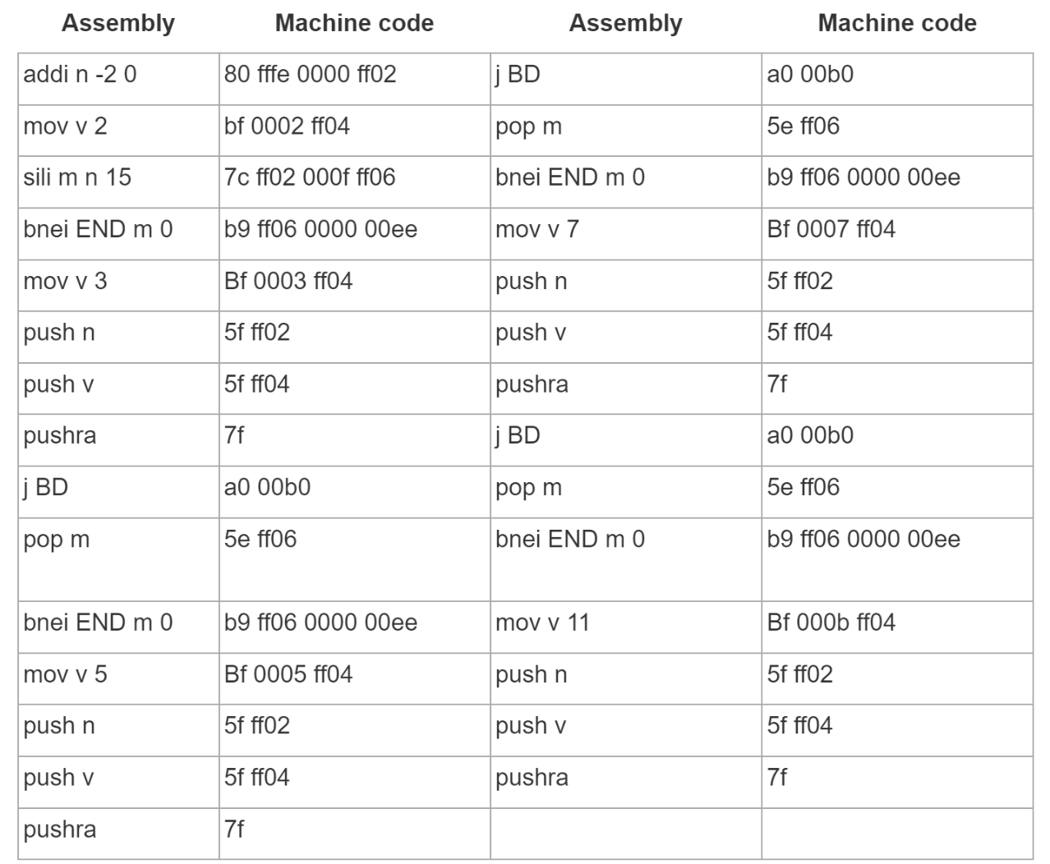
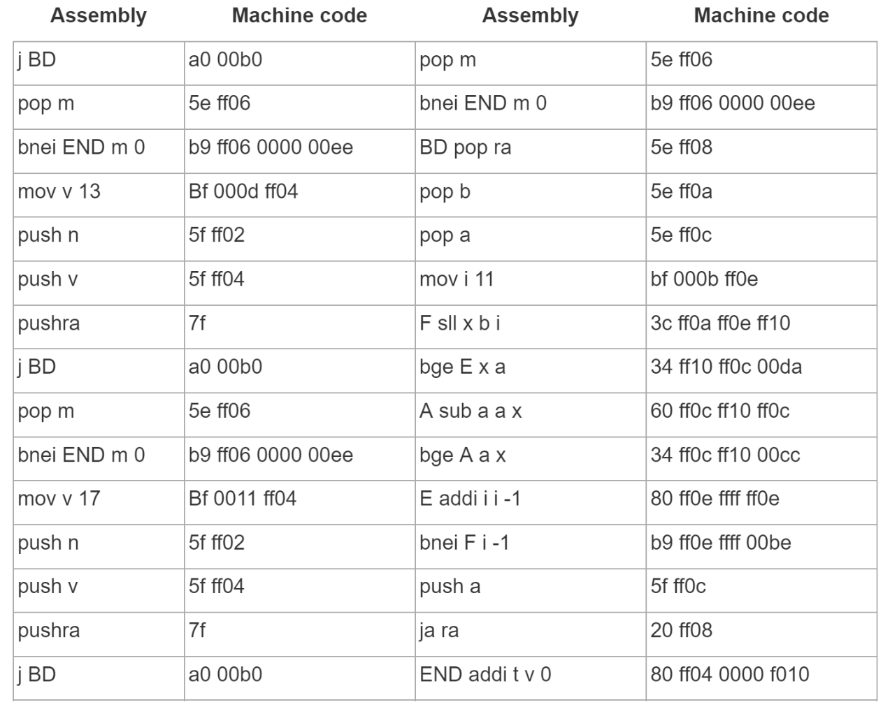
Super Fast RelPrime
Notes:
Garrett

Slide 13


Performance
Regular RelPrime
Fast RelPrime
Input: 0x13b0
Total instructions: 40876
Total cycles: 234,872
CPI: 5.746
CT: 10.3 ns
Execution Time: 2.41 ms
Input: 0x13b0
Total executed instructions: 294
Total Cycles: 1801
CPI: 6.13
CT: 10.3 ns
Execution time: 18.6 µs
Notes:
Ethan

Slide 14
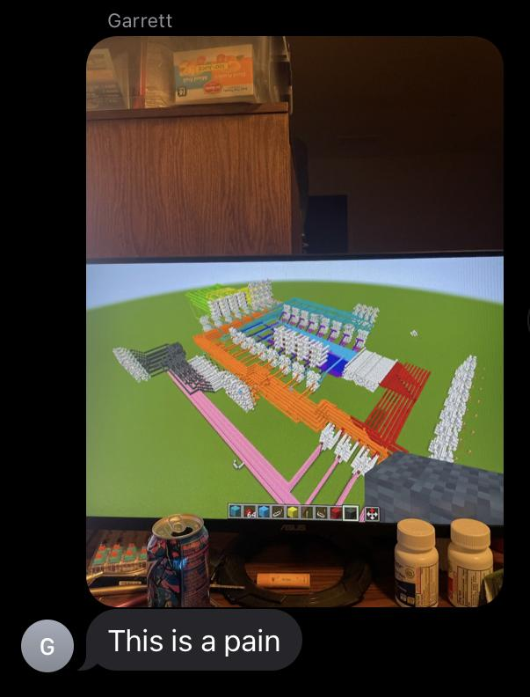
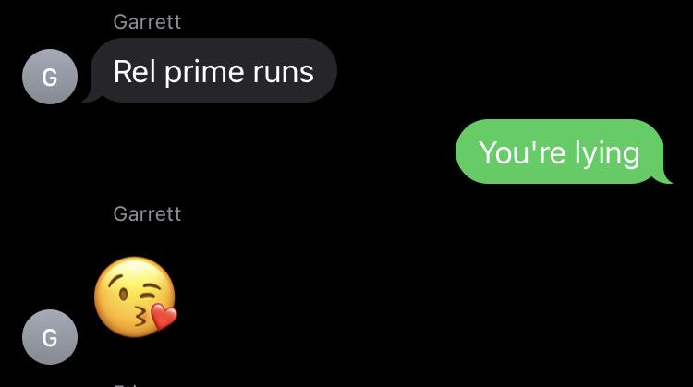
Any Questions?

Slide 15
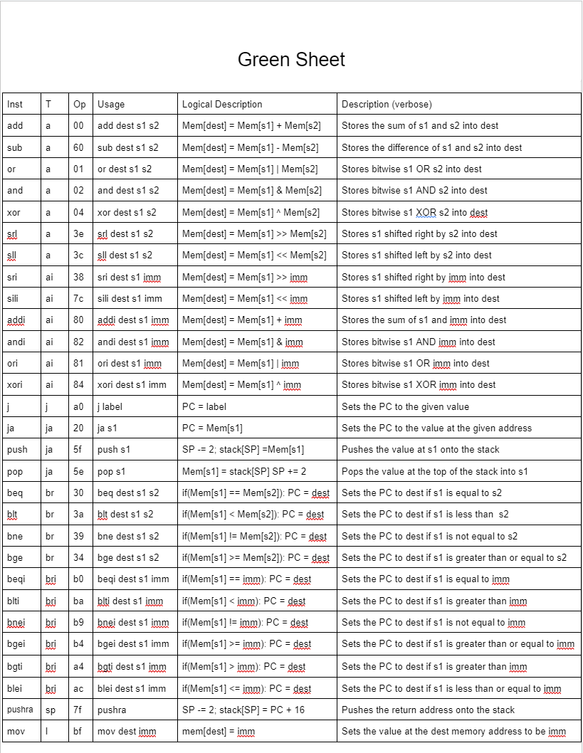

Slide 16
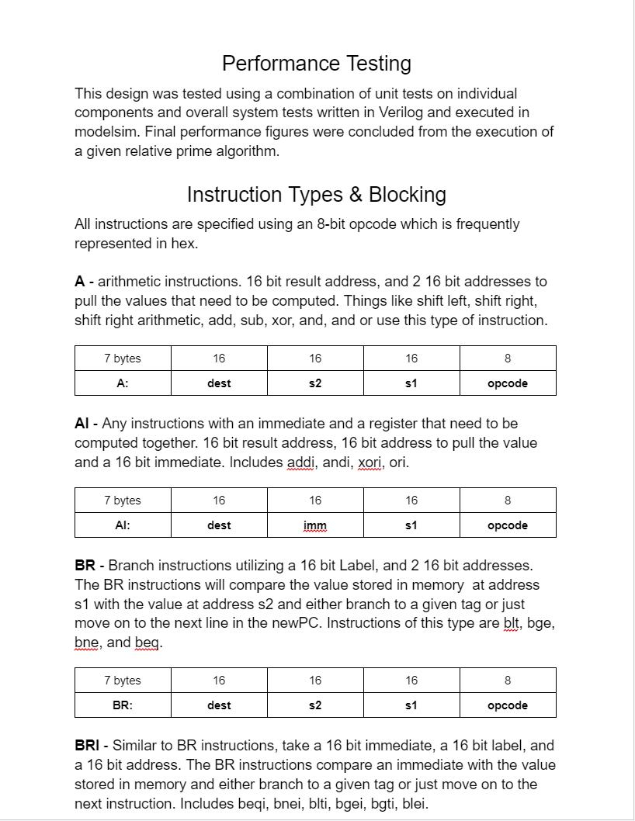
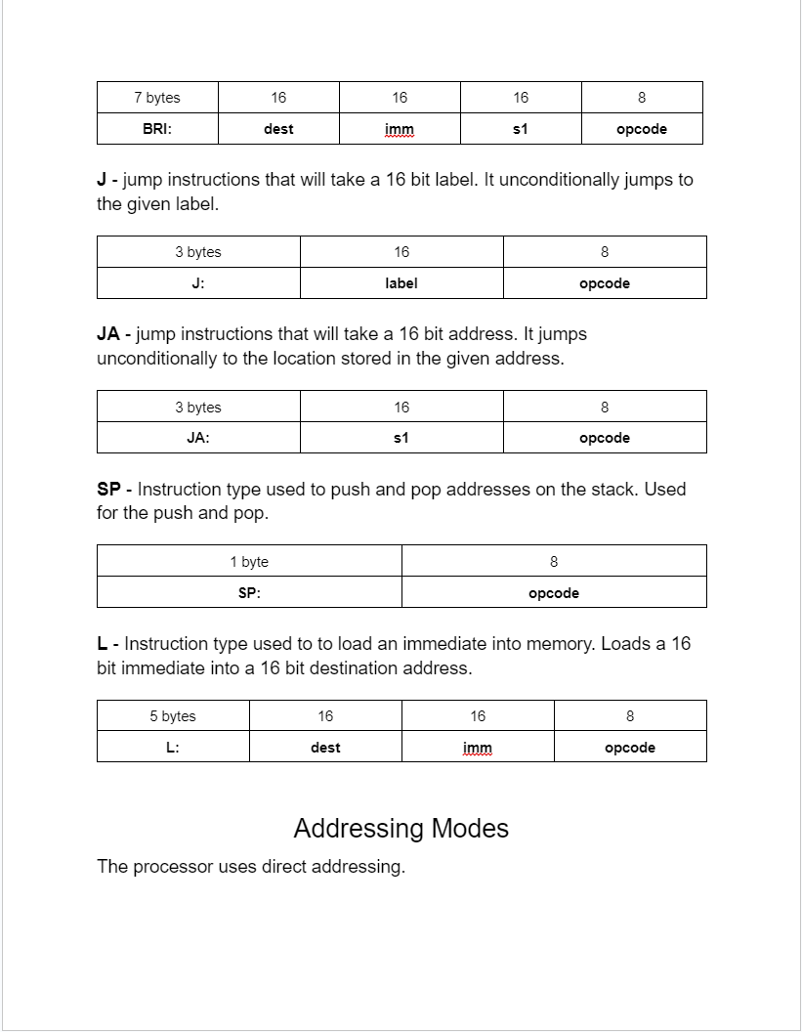

Slide 17
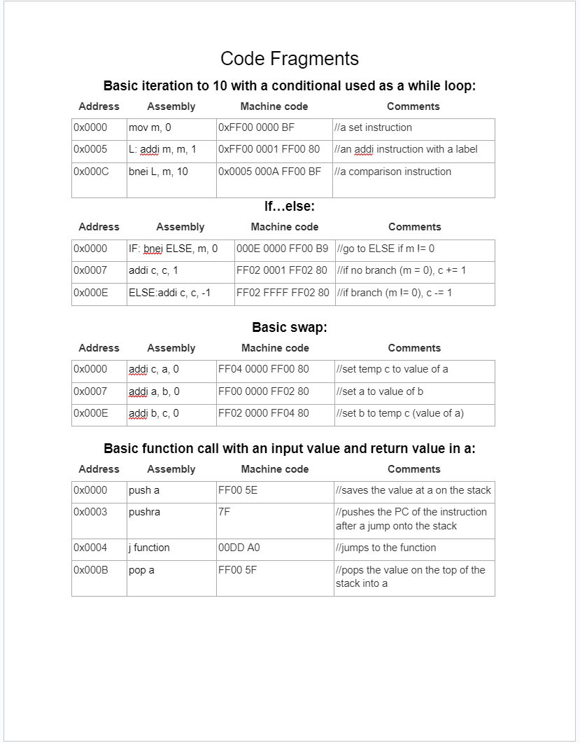
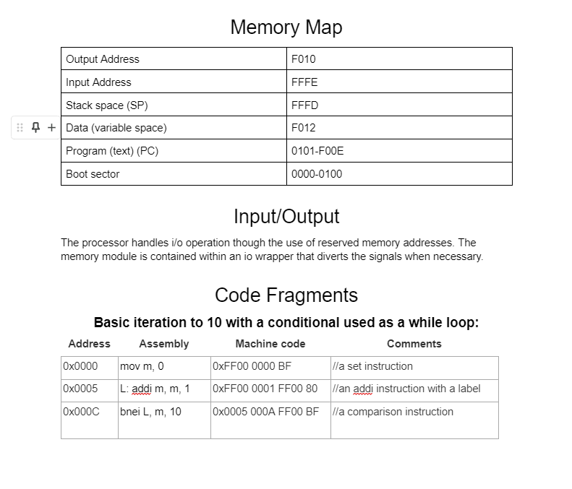

Slide 18
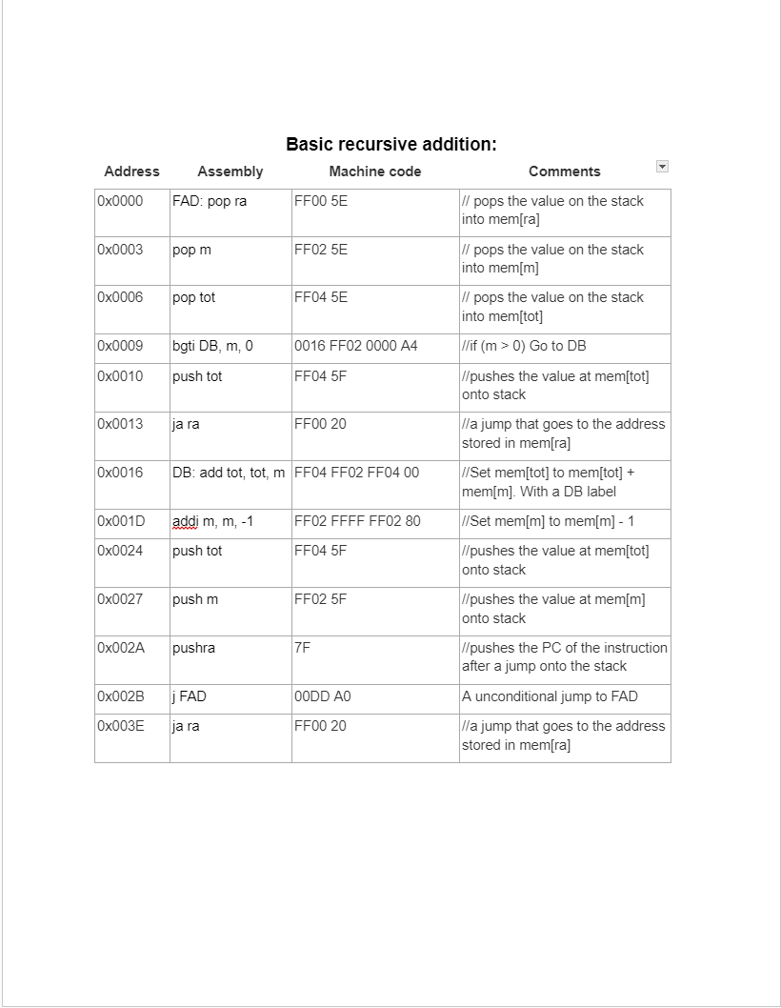
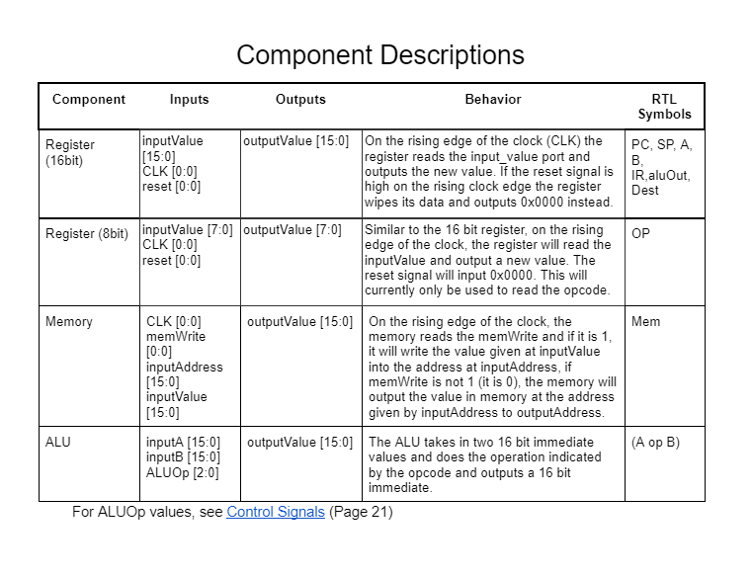

Slide 19
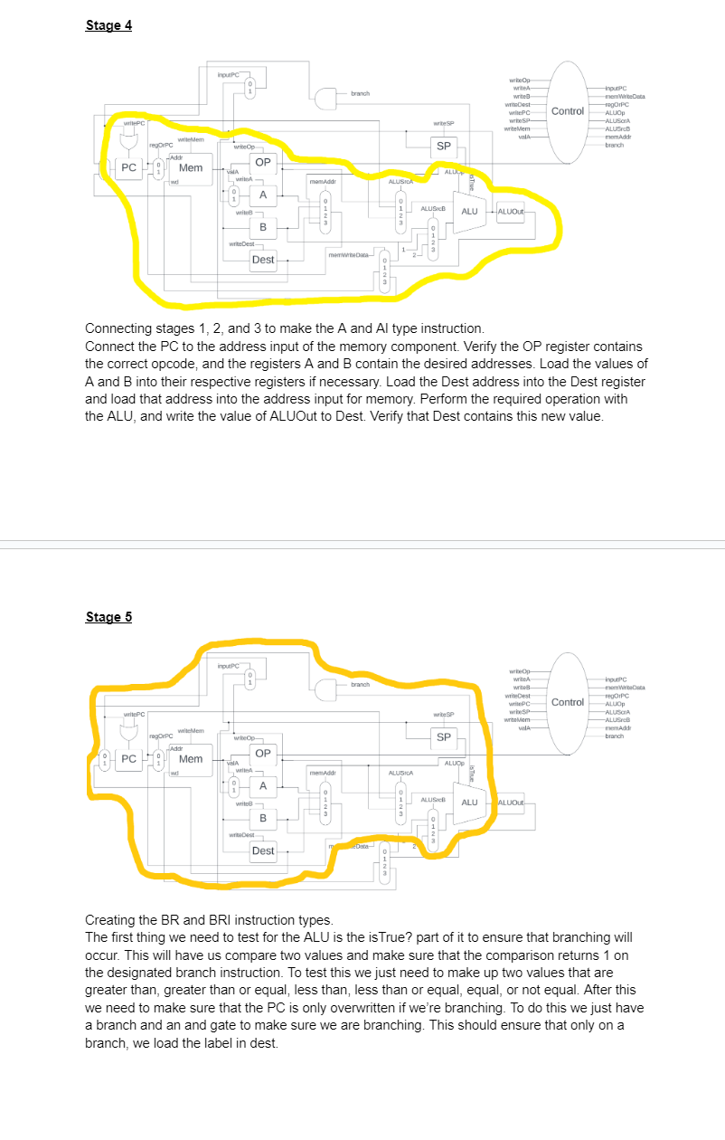
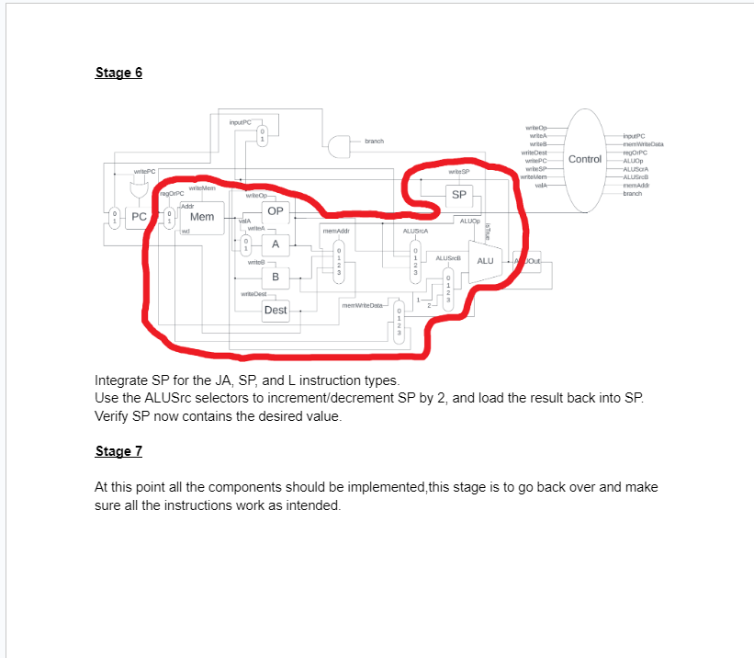

Slide 20
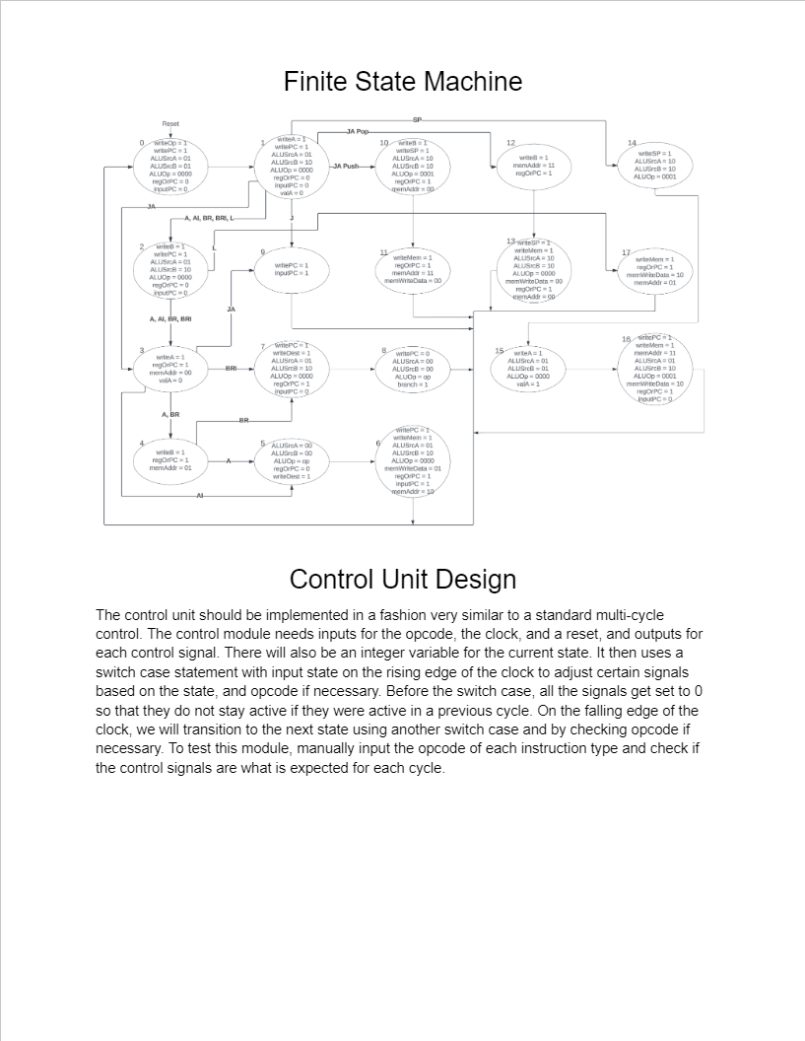
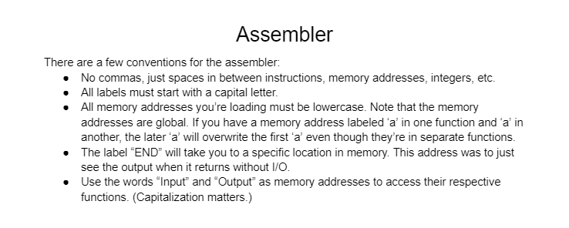
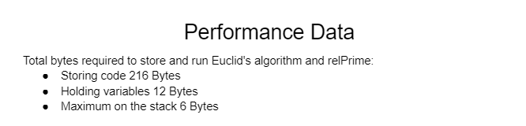

Slide 21
